Slide 1
Welcome to Week 04
Introduction to Data Structures
Slides by Cameron Mohne and Maggie Lee
Notes:
Did someone say dictionary? Welcome back to week 4 class

Slide 2
Agenda
01
02
Recap
Check-in
Going over functions and loops
How are you doing?
03
04
05
Index Game
List Practice
Heads Up
Refreshing list indexing!
Get practice creating and modifying lists!
Get practice functionally utilizing lists/dictionaries!
Notes:
We have quite a bit on the agenda today! When it comes to data structures, the conversations are really endless. We have only introduced two types of data structures, but there are many more! We also don’t have enough time to cover all of the tiny details of even just lists and dictionaries! So what will we be covering? We will have a small bit for our last check in. After that, we’ll go ahead and try to recap some of the important bits of data structures. Then, we’ll get into our section problems. The first is just a little game to warm up to indexing in lists. We’ll follow that up with a bit of practice with functions related to lists. Finally, we’ll finish things up with actually using lists to make our own implementation of a game!

Slide 3
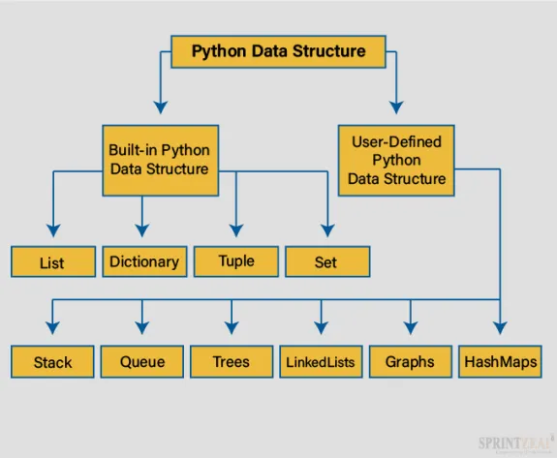
WHAT IS A DATA STRUCTURE?
“A way of arranging data on a computer so that it can be accessed and updated efficiently.”
A data structure is not only used for storing or organizing the data.
It is also used for processing, retrieving, and storing data.
There are different basic and advanced types of data structures that are used in almost every programming language or software system that has been developed.
Notes:
Good Source to explore:
https://docs.python.org/3/tutorial/datastructures.html#

Slide 4
Lists & Dictionaries
By Tooba Ahmed Alvi

Slide 5
RECAP FROM LAST LECTURE…
Function & Its Types
Importance of Functions
Scope of a Function
Concept of Global and Local Variable
For Loop & Nested For Loops
While Loop
Notes:
Unfortunately, it is the end of Code in Place. Let’s reminisce a bit, shall we? What was your favorite problem, section, or memory from your time here at Code in Place? I’ll go first!

Slide 6
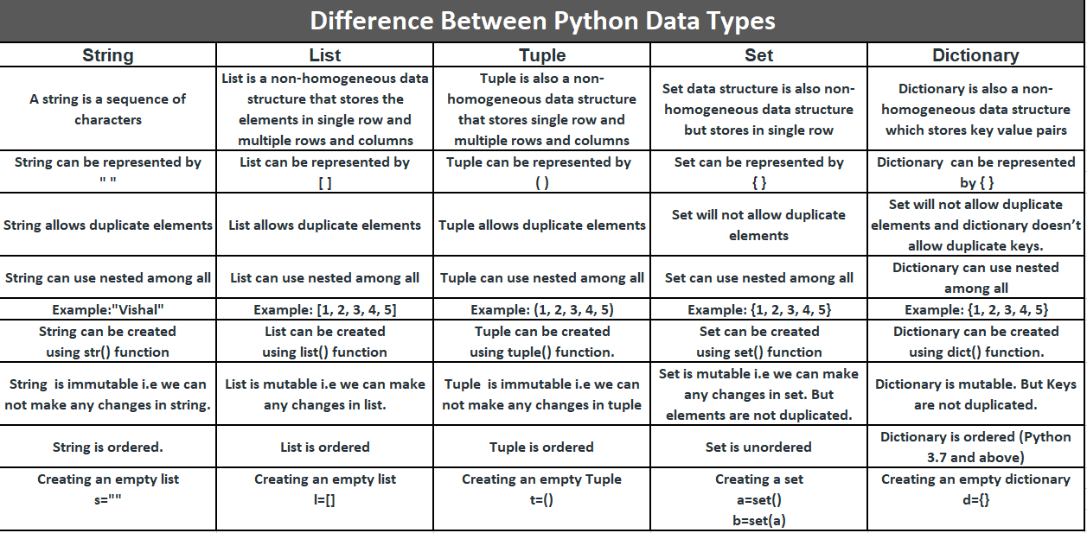
DIFFERENCES BETWEEN DATA STRUCTURES

Slide 7
Data Structures
[List]
{Dictionary}
An ordered collection of values. Usually used to store a “list” of similar data. One example might be an attendance roster. It’s usually in order alphabetically (but it doesn’t have to be) and stores a list of names!
An unordered collection of key/value pairs. Usually used to store relational data. One example is a phone book or a contact list in a phone. Each name has a number associated with it!
Notes:
First, I want to reiterate the differences between lists and dictionaries.
Lists are an ordered collection of data values. This doesn’t mean that the data is necessarily sorted and organized, but that the data themselves have a tag on them which tells us and the computer where it is in the data structure. We usually store alike data in this list. For example, if you go grocery shopping, you might have a list of food that you might want to buy.
On the other end, dictionaries are much more relational. Dictionaries contain key/value pairs. What this means is that each key is associated with a value. The value can be anything really. It could be a string, number, list, or even another dictionary! The key is how we find the value when we are accessing the dictionary. The best example to imagine is either a phone book or the contact list in a phone. Every person and business usually has a phone number attached to the contact name. The name would be a key, and the phone number a value!

Slide 8
CHARACTERISTICS - LISTS
An ordered, mutable, and heterogeneous collection of objects.
Order here implies that the gathering of objects follows a particular order.
Mutable means the list can be mutated or changed.
Heterogeneous implies that you’ll be able to mix and match any kind of object, or data type, within a List like an integer, string, or even another list.

Slide 9
Lists
:
Lists are ordered, meaning you can access items
Indexing starts at 0 in Python!
This means that the very first element in a list has index 0.
Lists are mutable, if you make changes to a list in a helper function, they actually modify the list!
Lists are heterogenous - You don’t need to contain data of the same type. It is just more common.
This means that a singular list can contain strings, integers, booleans, floats, and more.
This means that a singular list can contain strings, integers, booleans, floats, and more.
Lists are iterable objects. Meaning we can iterate over all the elements in a list.
Lists are like dynamically sized arrays found Lists are iterable objects. Meaning we can iterate over all the elements in a list.
Lists are like dynamically sized arrays
Notes:
Just read the bold.

Slide 10
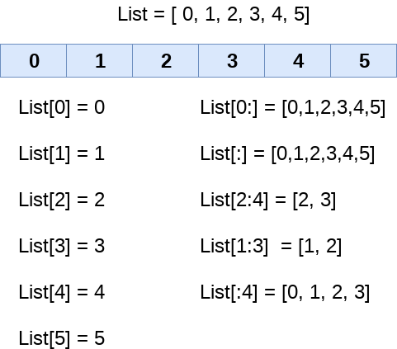
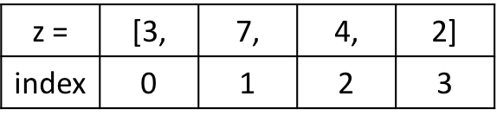
LISTS - EXAMPLES
# Define a list
z = [3, 7, 4, 2] → [int,int,int,int]
# Define a list
heterogeneous Elements = [3, True, 'Michael', 2.0] → []

Slide 11
Lists
Some useful documentation:
list_name = []
list_name = [value_1, value_2, ..., value_n]
list_name.append(elem)
list_name.insert(index, elem)
list_name.remove(elem)
popped_item = list_name.pop(index)
accessed_item = list_name[index]
Notes:
A quick refresher on how to use lists!
First line is how to make an empty list
Second is how to create a list with values inside of it already
Third line is how to add to the back of the list
Fourth line is inserting an item at a specific index in the list
Fifth line is removing the first instance of an item
Sixth line is popping and returning an item at a specific index
The last line is how to access and return an element at a specific index

Slide 12
Index Game
Notes:
(Takes place in the IDE) https://codeinplace.stanford.edu/cip4/ide/a/indexgame
We are going to play a quick game to reinforce our knowledge of how indexing works with lists. We’ve already been given code for the game, so I’m going to go ahead and open it and we can play!

Slide 13
List Practice
Notes:
https://codeinplace.stanford.edu/cip4/ide/a/fruitlist
Next, we are going to revisit our understanding of some of the functionalities lists have as a precursor to our last section problem.
(Would recommend short breakout rooms or individual writing for a bit with a group recap)

Slide 14
Dictionaries
Some useful documentation:
dict_name = {}
dict_name = {key: value, key2: value_2, ...}
dict_name[key] = value
del dict_name[key]
value = dict_name.pop(key, None)
value = dict_name[key]
value = dict_name.get(key)
Notes:
A quick refresher on how to use lists!
First line is how to make an empty dict
Second is how to create a dict with key/value pairs inside of it already
Third line is how to add a new item to the dict
Fourth line is deleting a key/value pair from a dictionary
Fifth line is returning a key’s value and then deleting the key/value pair from the dictionary. You can technically leave out the ‘None’ part, leaving it in means that if the key wasn’t found, then the default value you want to return is None. If you leave it out, it’ll throw an error instead.
Sixth line is unsafely accessing a key’s value and returning it
The last line is how to access and return a key’s value without needing to check if it’s in the dict first. It’ll just return None instead (or you can set its value like how we did with pop).

Slide 15
Dictionaries
Some basic reminders regarding dictionaries:
Often short handed in writing/speech to dict.
Also mutable, just like lists
Make sure keys are in a dictionary or have some check to see if they are there before trying to access or delete data.
This is usually needed when trying to use user input in conjunction with dictionaries
Keys have to be unique
Keys can be anything that is hashable, are often strings, though.
Notes:
Just read the bold.
If they ask about hashability and you don’t know anything about that, send them to the public forum.

Slide 16
Count Nums
Notes:
https://codeinplace.stanford.edu/cip4/ide/a/countnums
This program counts the number of times each number appears in a list. It uses a dictionary to keep track of the information.
An example run of the program looks like this (user input is in blue):

Slide 17
Phone Book
Notes:
https://codeinplace.stanford.edu/cip4/ide/a/phonebook
In this program we show an example of using dictionaries to keep track of information in a phonebook.

Slide 18
Heads Up
Notes:
The problem is called Heads Up and should hopefully combine the prior knowledge from the previous two problems.

Slide 19
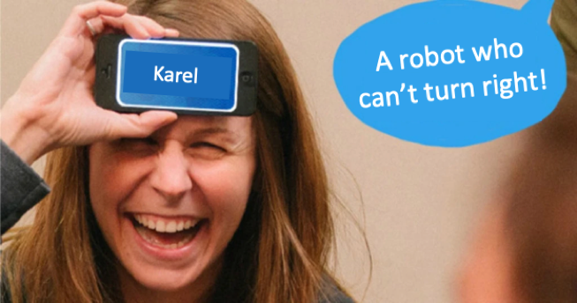
Assignment 4 - Problem # 1
Heads Up is a game where one person takes the role of a “guesser”. A word will be generated at random, and everyone who isn’t the guesser will provide hints as to what the word is, without saying the actual word. The guessers job is to guess what the word is as fast as possible! An example of a round of this game is shown on the right.
Notes:
First, what even is Heads Up?
Well it’s a party game that is pretty popular in the United States (and perhaps elsewhere?)
How it works is a program generates a random word. There will be a person with their eyes closed who is the guesser. The rest of the section will be trying to give verbal hints as to what the word is without saying the actual word or parts of the word. The guesser has to use those hints to guess the word as fast as possible!

Slide 20

Problem Overview
We are all going to become game developers today, as our job is to recreate the functionality of this game!
We are going to take a list of words from a file and then use that list with our knowledge of Python to recreate a console-based version of this game!
Notes:
Our job is to put on our game developer hats and recreate the base functionality of this game. We want to take a list of words and be able to mimic the flow of the game.

Slide 21
End Goal
Example Input
Example Output
(Example Word List)
Apple
Banana
Pear
Blueberry
Strawberry
Longan
Lychee
Tamarind
Orange
The word to guess: Lychee
Hit ‘enter’ to get the next word.
The word to guess: Pear
Hit ‘enter’ to get the next word.
The word to guess: Longan
Hit ‘enter’ to get the next word.
...
Notes:
An example might be here, where we have a word list containing fruit names. An example output from our program might be something like this on the right where we get a word to guess, the program stops while we play, and then we move on to the next word when we are ready.

Slide 22
Problem Details
Words
We provide a list of words for you to use in a file named “cswords.txt”.
Files
We are given a function that will read words from a file for us called get_words_from_file(...).
Game Loop
We want to repeat the game infinitely (or until we hit the stop button at the top of the IDE)
Notes:
Some important details is that we already have a list of words we can use. We have a function to read the words from a file into a list for us already. And lastly, we want to keep playing the game forever until we use the stop button at the top. This is just to make life a bit easier!

Slide 23
Assignment Problem #2
There's a small fruit shop nearby your house that you like to buy from. Since you buy several fruit at a time, you want to keep track of how much the fruit will cost before you go. Luckily you wrote down what fruits were available and how much one of each fruit costs.
Write a program that loops through a dictionary of fruits, prompting the user to see how many of each fruit they want to buy, and then prints out the total combined cost of all of the fruits.
Here is an example run of the program (user input is in bold italics):
How many (apple) do you want?: 2
How many (durian) do you want?: 0
How many (jackfruit) do you want?: 1
How many (kiwi) do you want?: 0
How many (rambutan) do you want?: 1
How many (mango) do you want?: 3
Your total is $99.5

Slide 24
Coding Time!
Notes:
https://codeinplace.stanford.edu/cip4/ide/a/headsup

Slide 25
Questions?
Notes:
It is also nice to look back on how far we’ve come, thanks for sharing everyone! Before we jump into the recap, are there any questions?

Slide 26
REFERENCES & ASSIGNMENT LINK
https://docs.python.org/3/tutorial/datastructures.html

